Slide 1

FORENSIC NURSING

Slide 2
INTRODUCTION
Forensic nursing is a newly evolved Innovative nursing specialty that search for medicolegal health care issues. The vision of forensic nursing speciality has advanced from societies need to reduce and prevent interpersonal violence and crimes.

Slide 3
DEFINITION
Forensic nursing is defined as the application of the nursing process to public or legal proceedings and the application of forensic health care in the scientific investigation of trauma and or death related to abuse, violence , criminal activity, liability , and accidents .
Lynch ,2004
Forensic nursing is the practice of nursing globally when health and legal systems interset.
ANA and IAFN, 2009

Slide 4
HISTORY OF FORENSIC NURSING
1948 Universal declaration of human rights pronounces the article V that " no person will be subjected to torture or to cruelty, in human or degrading treatment or punishment"
1951 Historical Chinese documents additionally found out evidence in the scientific death investigation and wound identification. It turned into most effective way for forensic nursing.
1975 Chief Medical Examiner in Canada,John Butt acknowledges the registered nurse as an important resource to the field of death investigation.
1984 An USA surgeon identify the violence as a public health issue and health care providers as key agent in reducing the effects of violence from society.

Slide 5
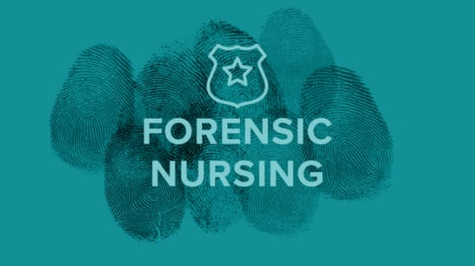
1990 Role of forensic nurse examiner was conceptualizes by Virginia Lynch
1991 The American Nurses Association publishers a paper on violence against women is a nursing practice issue.
1992 The American Academy of Forensic Sciences identifies forensic nursing as a scientific discipline.

Slide 6
1995 The International Association of Forensic Nurses was established as the first professional nursing organization for forensic nurses.
1997 The American Nurses Association's Congress of the nursing practice recognizes forensic nursing as a speciality .
2005 The Journal of Forensic Sciences publishes its first issue.

Slide 7
SCOPE OF FORENSIC NURSING
Clinical forensic nurse.
Forensic nurse investigators
. Sexual assault nurse examiner
. Forensic psychiatric nurse
. Forensic correctional nurse
. Legal nurse consultants
Nurse attorney
Nurse coroner
Forensic nurse educator.

Slide 8
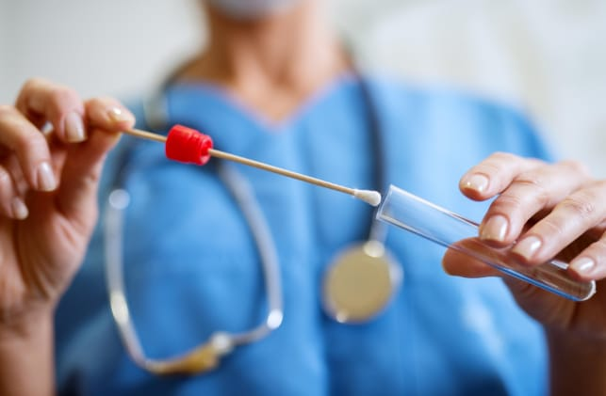
Forensic clinical nurse specialist
It is a newest specialisation in nursing .
Requires a masters or doctoral degree in forensic nursing.
Develop and implements policies related to forensic issues and health care , conducts research in forensic nursing , defense the patient's legal rights by proper collection and documentation of evidence .

Slide 9
Forensic nurse investigator
work alongside law enforcement to gather evidence in cases of sexual assault and domestic violence.
Sexual Assault Nurse Examiner
To provide comprehensive care to sexual assault patient , who demonstrate competency in conducting a forensic examination.
Sexual assault nurse examiner for adults ( SANE -A)
Sexual assault examiner for Pediatric ( SANE-P ).

Slide 10
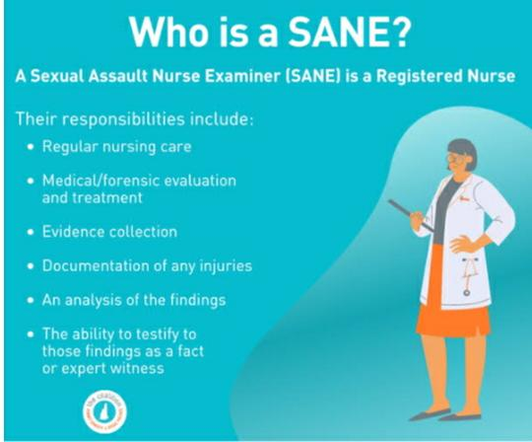

Slide 11
Forensic Nurse Death Investigator
Apply the nursing process to death investigation across the lifespan.
Collaborate with interdisciplinary agency
Identify trends
Participates in research
Promote health and safety through community education.
Apply nursing knowledge
Questions are formulated based on a medical knowledge base.

Slide 12
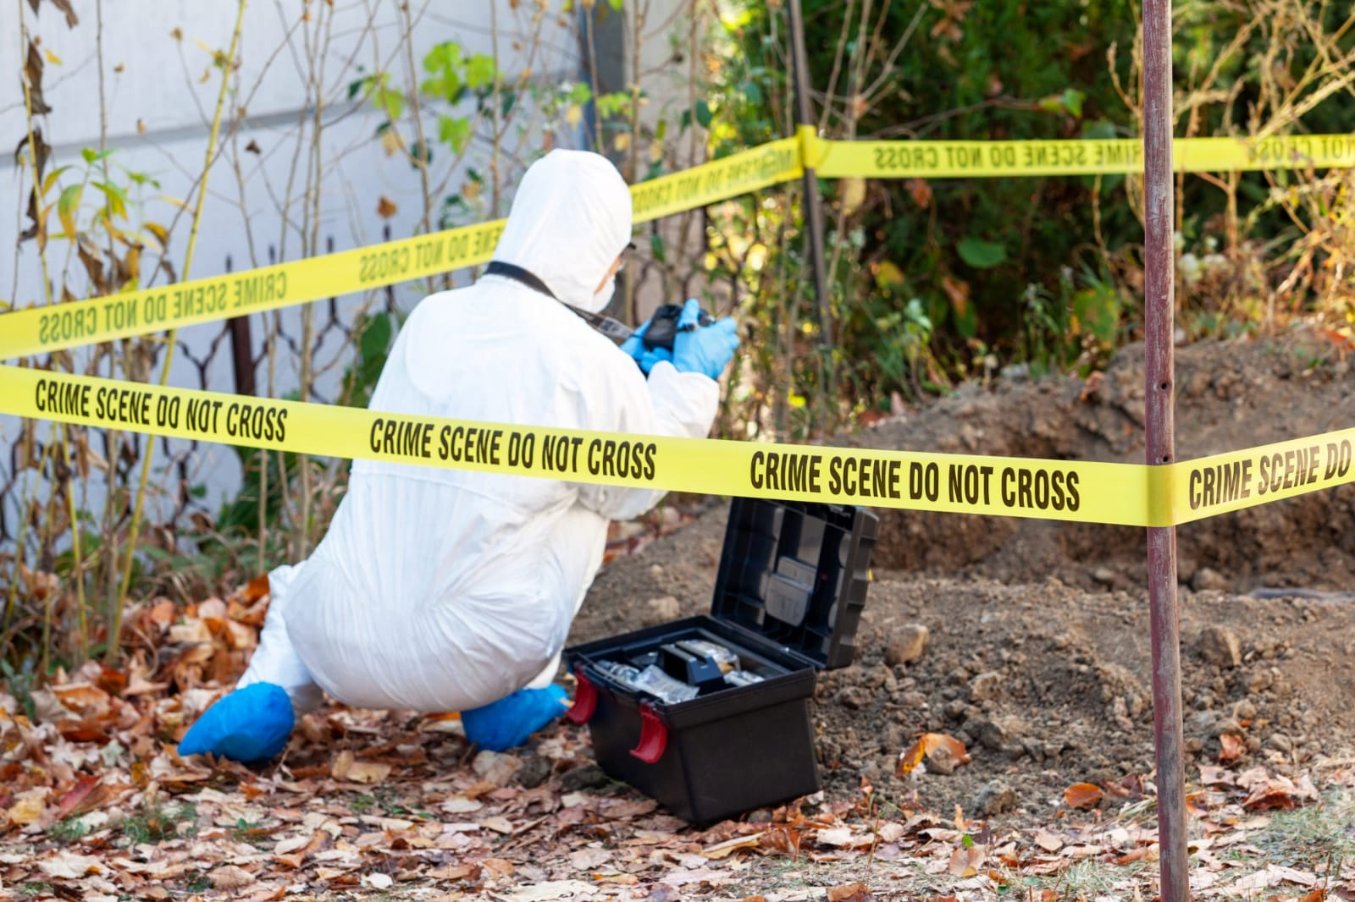

Slide 13
Forensic Nurse Examiner
Forensic nurse examiner should have knowledge in both medicine and law.
They are specially trained to provide holistic and comprehensive care to victims and offenders.

Slide 14
Forensic Psychiatric Nurses. (FPN)
Evaluating individuals who requires court- ordered Psychiatric evaluation
Treating criminal offenders
Advocacy for accessed to psychiatric mental health services
Promotion of mental health
Prevention Of psychiatric disorder
The equitable provinsion of care for children and adolescent

Slide 15
Forensic Correctional , Institutional or Custodial
Nurse.
Correctional nurses must often work closely with corrections officers in situations such as emergencies in the housing units or monitoring inmates for medical attention.

Slide 16
Legal Nurse Consultant /Nurse Attorney
Legal consultant provides education to health care Personnel about identification, analysis,preservation ,documentation of personal injury, malpractice,among all legal issues related to medicolegal cases.
Nurse attorney is a registered nurse with a doctorate degree who trained as an attorney law ,and also has specialisation in civil and criminal cases involving health care related problems. They interact with the people who are vulnerable ,who has been injured or traumatized.

Slide 17
Nurse Coroner
A Nurse Coroner is a type of forensic nurse who assists the coroner in determining the cause and time of death
Assist police at a crime scene.
They should be skilled in pathology,physiology,obsevation,preservation,documentation of evidence , and in understanding legal and criminal proceedings for violent crimes.

Slide 18
Settings of forensic nursing practice.
The areas of practice of a forensic nurse signals include hospital, long term care ,clinical setting ,advocacy center, family health centers , correctional facilities , nonprofit organization , and public sector.

Slide 19
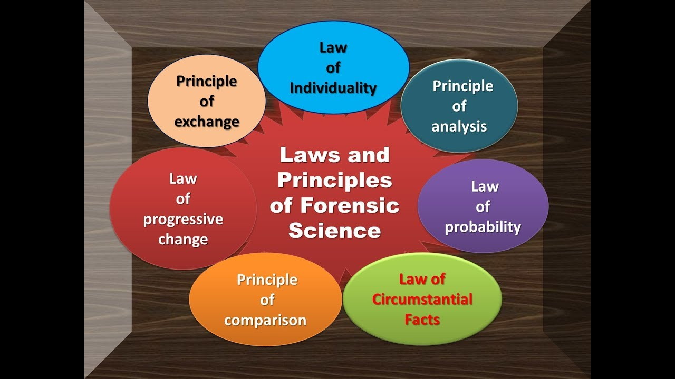
PRINCIPLES OF FORENSIC SCIENCE

Slide 20
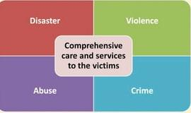
ROLES AND RESPONSIBILITY OF FORENSIC NURSE

Slide 21
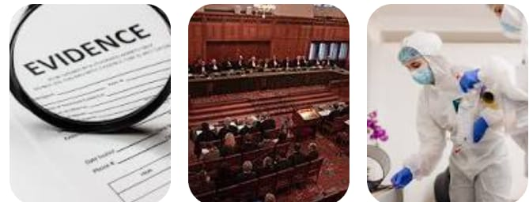
Providing nursing or medical care
Obtain medical or forensic history
Physical examination
Evidence collection
Photograph injury
Collaborate with other team members
Testifying in the court

Slide 22
INC AND SNC ACTS
Indian Nursing Council Act, 1947 :
This act summarily defines who can work as a nurse, the basic qualifications required and the conditions under which the recognition becomes invalid.some of the sections of the act pertaining to the nursing qualification ,licensure and practice are discussed.

Slide 23
The act also specifies the names of authorized agencies who can issue a certificate, degree or diploma in a particular nursing field or specialization.
The council may appoint members to inspect any institution which is recognized to train and certify nursing qualification.

Slide 24
SNC(State Nursing council Act )1953
SNC functioning in each state nursing council are functioning in each state of India to regulate the education , registration,licensure and practice of nurse in respective states.

Slide 25
Function of SNC
To give registration to nurses and midwives who had undergone their training from recognized institutions.
To conduct examinations for GNM,ANM,post basic Diploma courses and health supervisor courses.
To conduct undergraduate courses and to issue diploma and registration certificate.
Power to withdraw the recognition of qualification in case of institution fails to maintain its standards.

Slide 26


